Slide 1



Intention and
Motor Representation
in Joint Action
s.butterfill@warwick.ac.uk
Intention and Motor Representation in Joint Action
s.butterfill@warwick.ac.uk & corrado.sinigaglia@unimi.it

Slide 2
premise:
Reciprocal agent-neutral motor representation enables joint action
Notes:
As a philosopher I’m going to start from an empirically controversial premise.
I don’t think this premise has been established, but I do think it’s a reasonable bet.

Slide 3
premise:
Reciprocal agent-neutral motor representation enables joint action
Notes:
A motor representation is \emph{agent-neutral} if it concerns an action which is not one’s one or, in the case of joint action, not entirely one’s own.

Slide 4
premise:
Reciprocal agent-neutral motor representation enables joint action
Notes:
Two or more motor representations are \emph{reciprocal} just if there is a single outcome which each motor representation represents.

Slide 5
premise:
Reciprocal agent-neutral motor representation enables joint action
Notes:
Sometimes I’ll using the term \emph{social} motor representation for reciprocal agent-neutral motor representations.
I have a slightly bad conscience about this because I’m not sure they’re actually social in any ordinary sense.
It is almost uncontroversial that agent-neutral motor representations exist, and I see no reason to doubt that they could be reciprocal.
The controversial part of the premise is the claim that such representations can enable joint action.
I should say, by the way, that I’m not suggesting that reciprocal agent-neutral motor representation is involved in every joint action.
Perhaps some joint actions do not involve social motor representation.
The premise is just that social motor representation is among the factors which enable some joint actions.

Slide 6
premise:
Reciprocal agent-neutral motor representation enables joint action
question:
Does reciprocal agent-neutral motor representation also play a role in explaining what joint action is? [Yes]
challenge:
How could social motor representation and shared intention harmoniously contribute to joint action?
Notes:
I’m not going to defend the premise, although I will try to explain the premise in more detail in a moment. But first let me outline where I’m going with this.

Slide 7
premise:
Reciprocal agent-neutral motor representation enables joint action
question:
Does reciprocal agent-neutral motor representation also play a role in explaining what joint action is? [Yes]
challenge:
How could social motor representation and shared intention harmoniously contribute to joint action?
Notes:
The premise leads to a question and, relatedly, to a challenge.

Slide 8
premise:
Reciprocal agent-neutral motor representation enables joint action
question:
Does reciprocal agent-neutral motor representation also play a role in explaining what joint action is? [Yes]
challenge:
How could social motor representation and shared intention harmoniously contribute to joint action?
Notes:
The question is whether social motor representation is not only an enabling condition for joint action but also plays a role in explaining what joint action is. I want to argue that it does. In fact I want to argue that it plays a role similar and complementary to that of shared intention.

Slide 9
premise:
Reciprocal agent-neutral motor representation enables joint action
question:
Does reciprocal agent-neutral motor representation also play a role in explaining what joint action is? [Yes]
challenge:
How could social motor representation and shared intention harmoniously contribute to joint action?
Notes:
After this, in the last part of my talk, I also want to point to a challenge raised by the existence of social motor representation. The challenge is roughly this: planning for joint action involves representations of target outcomes in two different formats, a motor format and a propositional format. Given that representations of these different formats cannot straightforwardly be inferentially integrated, what could ever insure that there is sometimes non-accidental harmony between motor representations and shared intentions?

Slide 10
premise:
Reciprocal agent-neutral motor representation enables joint action
question:
Does reciprocal agent-neutral motor representation also play a role in explaining what joint action is? [Yes]
challenge:
How could social motor representation and shared intention harmoniously contribute to joint action?
Notes:
Let me start by explaining the premise: Reciprocal agent-neutral motor representation enables joint action.
Why think this?
A direct way to test the premise would be to selectively intervene on social motor representation and see how it affects agents’ performance of joint actions.
As far as I know no one has done this.
But there are some indirect findings.
I shall mention just one, a finding by Dimitris Kourtis and colleagues.

Slide 11

premise:
Reciprocal agent-neutral motor representation enables joint action
“Simulation of another person’s action, as reﬂected in the activation of motor cortices, gets stronger the more the other is perceived as an interaction partner.”
--- Kourtis, Sebanz & Knoblich (2010, p. 4)

Slide 12
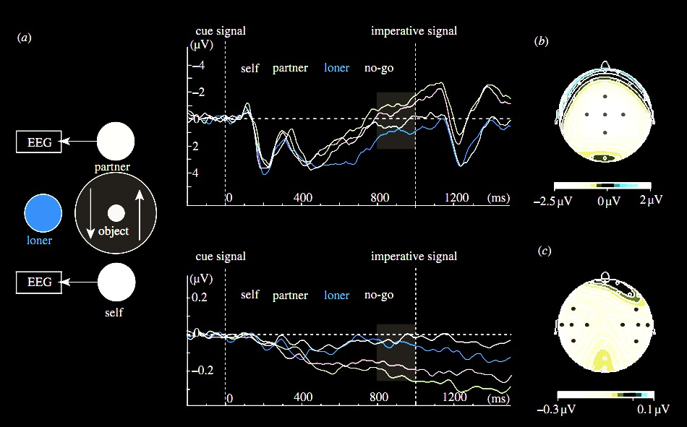
premise:
Reciprocal agent-neutral motor representation enables joint action
Kourtis, Sebanz & Knoblich (2010)
Notes:
Here’s the experiment they did.
The task was simple: two people sat opposite each other. Sometimes they acted alone, picking up and replacing an object. And sometimes had to act together, passing an object between them. Also present was the ‘loner’ who always acted alone.

Slide 13
premise:
Reciprocal agent-neutral motor representation enables joint action
Kourtis, Sebanz & Knoblich (2010)
Notes:
EEG measurements of motor activation were recorded.

Slide 14
premise:
Reciprocal agent-neutral motor representation enables joint action
Kourtis, Sebanz & Knoblich (2010)

Slide 15
premise:
Reciprocal agent-neutral motor representation enables joint action
Kourtis, Sebanz & Knoblich (2010)
Notes:
The researchers found that patterns of activation for self & joint action partner were similar, and different from patterns of activation for the actions of the loner which were similar to patterns in a ‘no go’ condition where no one was to act.

Slide 16
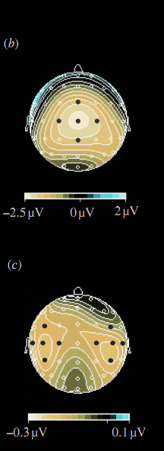
premise:
Reciprocal agent-neutral motor representation enables joint action
Kourtis, Sebanz & Knoblich (2010)
Notes:
So here’s what I take from this paper.
If you are engaged in a joint action with someone, one which involves moving an object by passing it between you, then each of you has motor representations of the other’s actions and these motor representations are functionally equivalent to motor representations of your own actions in the sense that they are just the sorts of representation that might have caused you to do what the other is doing (if you were in her position).

Slide 17
premise:
Reciprocal agent-neutral motor representation facilitates joint action
Kourtis, Sebanz & Knoblich (2010)
Notes:
Suppose that Kourtis et al are right that social motor representation is more likely to occur in joint action than when one is merely observing.
How could this facilitate joint action?

Slide 18
How could reciprocal agent-neutral motor representation enable joint action?
Notes:
Suppose that Kourtis et al are right that social motor representation is more likely to occur in joint action than when one is merely observing.
How could this facilitate joint action?

Slide 19
Move it from there to here
Notes:
Let’s step back and consider an individual action.
An agent moves a mug from one place to another, passing in from her left hand to her right hand half way [*demonstrate].
It’s a familiar idea that motor representations for planning and monitoring action involve an hierarchical structure,
where there is a relatively abstract representation of an outcome that is progressively filled in.

Slide 20
Move it from there to here
get it
move it
position it
hand-1
reach
grasp
move
arrive
release
hand-2
reach
grasp
move
place
release
Notes:
I don’t suppose that this attempt to depict the hierarchy of motor representations involved in moving a mug with two hands is accurate.
I’m only trying to illustrate two familiar ideas.
One is that motor planning involves starting with relatively abstract representations of outcomes and filling in details.

Slide 21
Move it from there to here
get it
move it
position it
hand-1
reach
grasp
move
arrive
release
hand-2
reach
grasp
move
place
release
Notes:
The other is that there is a need, even for a single agent, to synchronize the exchange between the two hands.
How is this relevant to the case of joint action?

Slide 22
joint action: same goal
Move it from there to here
get it
move it
position it
hand-1
reach
grasp
move
arrive
release
hand-2
reach
grasp
move
place
release
Notes:
In joint action the agents have the same goal, to move the object from there to here.

Slide 23
joint action: same goal
Move it from there to here
get it
move it
position it
hand-1
reach
grasp
move
arrive
release
hand-2
reach
grasp
move
place
release
similar timing problem
Notes:
They also face a similar coordination problem, requiring a precisely timed swap

Slide 24
joint action: same goal
Move it from there to here
get it
move it
position it
same planning
hand-1
reach
grasp
move
arrive
release
hand-2
reach
grasp
move
place
release
similar timing problem
Notes:
And Koutis et al’s findings (and others’ findings) suggest that the same planning in involved in the joint action case, almost up to the actual muscle contractions.
That is, in the joint action situation each agent plans both agents’ actions as if they were the actions of a single agent.
This may be what enables them to coordinate so well : each is able to plan her own actions in a way that meshes with the other agent’s actions because each agent is planning (and monitoring) both their actions almost as if a single agent were going to execute the whole action.
And of course this is exactly what we want for small-scale joint action---we want two or more agents to act as one.

Slide 25
joint action: same goal
Move it from there to here
get it
move it
position it
same planning
hand-1
reach
grasp
move
arrive
release
hand-2
reach
grasp
move
place
release
inhibition needed
similar timing problem
Notes:
So what is the difference between the individual and the joint case? From the point of view of motor representation, the primary difference may be that in joint action there is a need to inhibit execution of the parts of the action which are not one’s own.
Here then is the basic idea I take to be guiding Kourtis and others.
The idea is that coordination is sometimes achieved by having each agent’s motor system plan all of their actions;
given some assumptions, this could be a way of making it likely that each will execute their part in the joint action in a way that meshes with the way the other agents execute their parts.
Now so far I’ve only been considering a possible role for social motor representation in enabling joint action.
But I think we the details already give us grounds for holding that motor representation has a role to play in explaining what joint action is.
How does this work?
Let’s go back to individual action for a moment again.

Slide 26
What is the relation between a purposive action and the outcome or outcomes to which it is directed?
out
action
out
act
out
out
Notes:
A basic question about ordinary, individual action is:
What is the relation between a purposive action and the outcome or outcomes to which it is directed?
Many ordinary purposive actions have many different outcomes.
Grabbing little Isabel by the hands I swing her around, causing her to laugh and, simultaneously, breaking a vase.
In fact the outcome to which this purposive action was directed might not be among its actual outcomes; after all, actions can fail.

Slide 27
What is the relation between a purposive action and the outcome or outcomes to which it is directed?
out
action
out
out
act
out
out
Notes:
So among all the actual and possible outcomes of my action, one or some are singled out as specially related to this action.
One aspect of the question concerns what singles out the outcome or outcomes, actual or merely possible, to which a particular purposive is directed.
But there is also a second aspect ...

Slide 28
What is the relation between a purposive action and the outcome or outcomes to which it is directed?
wave
out
action
out
reach
act
out
grasp
out
scratch
Notes:
Ordinary purposive actions are sometimes composed of more than one motor action. My swinging Isabel around starts with my reaching for her wrists, grasping them and then spinning us around ... and my action doesn’t include other things which I might be doing simultaneously, like refusing a cup of tea with my eyes or trying to determine whether that smell is coming from Isabel’s sister Hannah’s nappy.

Slide 29
What is the relation between a purposive action and the outcome or outcomes to which it is directed?
wave
out
action
out
reach
act
out
grasp
out
scratch
Notes:
So another aspect of our question is what determines which activities comprise the purposive action and which do not.

Slide 30
What is the relation between a purposive action and the outcome or outcomes to which it is directed?
wave
out
action
out
reach
act
out
grasp
intention or motor representation
out
scratch
Notes:
The standard answer to this question involves intention.
An intention (1) represents an outcome, (2) coordinates the one or several activities which comprise the action; and (3) coordinate these activities in a way that would normally facilitate the outcome’s occurrence.
What binds particular component actions together into larger purposive actions? It is the fact that these actions are all parts of plans involving a single intention.
What singles out an actual or possible outcome as one to which the component actions are collectively directed? It is the fact that this outcome is represented by the intention.
So the intention is what binds component actions together into purposive actions and links the action taken as a whole to the outcomes to which they are directed.

Slide 31
What is the relation between a purposive action and the outcome or outcomes to which it is directed?
wave
out
action
out
reach
act
out
grasp
intention or motor representation
out
scratch
Notes:
Now as Elisabeth Pacherie has argued (and I’ve had a go at arguing this in joint work with Corrado Sinigaglia recently too),
motor representations are relevantly similar to intentions.
Of course motor representations differ from intentions in some important ways (as Pacherie also notes).
But they are similar in the respects that matter for explaining the purposiveness of action.
(1) Like intentions, some motor representations represent outcomes (and not merely patters of joint displacement, say).
(2) Like intentions, some motor representations play a role in coordinating multiple more component activities by virtue of their role as elements in hierarchically structured plans.
(3) And, like intentions, some motor representations coordinate these activities in a way that would normally facilitate the outcome’s occurrence.
So in the individual case, it seems to me quite straightforward that there is a role for motor representation to play in explaining the purposiveness of action [*explaining the possibility of purposive action?].
The claim is not that \emph{all} purposive actions are linked to outcomes by motor representations, just that some are.
In some cases, the purposiveness of an action is grounded in a motor representation of an outcome; in other cases it is grounded in an intention.
And of course in many cases it may be that both intention and motor representation are involved.

Slide 32
What is the relation between a purposive action and the outcome or outcomes to which it is directed?
wave
out
action
out
reach
act
out
grasp
intention or motor representation
out
scratch
Notes:
Now let’s turn to joint action.

Slide 33
joint
What is the relation between a purposive action and the outcome or outcomes to which it is directed?
wave
out
action
out
reach
act
out
grasp
intention or motor representation
out
scratch
Notes:
The same question we asked about ordinary, individual action also arises for joint action.
What is the relation between a purposive joint action and the outcome or outcomes to which it is directed?

Slide 34
joint
What is the relation between a purposive action and the outcome or outcomes to which it is directed?
out
joint
action
out
act
out
out
Notes:
And again the question has two aspects.
What singles out the outcome or outcomes to which a purposive joint action is directed?

Slide 35
joint
What is the relation between a purposive action and the outcome or outcomes to which it is directed?
wave
out
joint
action
out
reach
act
out
grasp
out
scratch
Notes:
And what binds together the various activities that make up the joint action?
The difference in the case of joint action is, of course, that these activities are not necessarily activities of a single agent.

Slide 36
joint
What is the relation between a purposive action and the outcome or outcomes to which it is directed?
wave
out
joint
action
out
reach
act
out
grasp
shared intention or social motor representation
out
scratch
Notes:
The answer to this question for the case of joint action is also superficially similar in the answer we gave in the case of ordinary, individual action.
A shared intention is what relates purposive joint actions to the outcomes to which they are directed.
For the shared intention
(1) involves a representation, on the part of each agent, of an outcome
(2) coordinates the several agents’ activities
and
(3) coordinates the several agents’ activities in such a that would normally facilitate the occurrence of the represented outcome.
It is in this sense that a shared intention can ground the purposiveness of a joint action.

Slide 37
joint
What is the relation between a purposive action and the outcome or outcomes to which it is directed?
wave
out
joint
action
out
reach
act
out
grasp
shared intention or social motor representation
out
scratch
Notes:
But what we saw earlier, what the research by Kourtis et al and others indicates, is that social motor representation can play a similar role to joint action.
Return to the example of a two agents moving an object in a way that involves passing it between them.
the motor representation
(1) involves a representation, on the part of each agent, of an outcome
In this case the outcome is the whole movement of the object
(2) coordinates the several agents’ activities
and
(3) coordinates the several agents’ activities in such a that would normally facilitate the occurrence of the represented outcome.
Because each agent represents the whole movement and plans all of its implementation irrespective of which parts she will actually perform, each agent plans the action in a way that should coordinate with the other agent’s plans providing they use similar planning procedures
[*What I’m saying here, in effect, is that both shared intention and social motor representation can yield a COLLECTIVE GOAL]

Slide 38
joint
What is the relation between a purposive action and the outcome or outcomes to which it is directed?
wave
out
joint
action
out
reach
act
out
grasp
shared intention or social motor representation
out
scratch
Notes:
What I’m suggesting is very simple.
If you think that in ordinary, individual action, the purposiveness of actions can be grounded by motor representations
(and you should think this because it’s true),
then you should also think the same about actions involving two or more agents---the purposiveness of a joint action can be grounded in motor representations as well as in shared intentions.

Slide 39

Sufficient conditions
We have a shared intention that we J if
“1. (a) I intend that we J and (b) you intend that we J
“2. I intend that we J in accordance with and because of la, lb, and meshing subplans of la and lb; you intend [likewise] …
“3. 1 and 2 are common knowledge between us”
(Bratman 1993: View 4)
Notes:
Let me try another way of presenting the same idea.
Here are Michael Bratman’s sufficient conditions for shared intention.
I want to suggest that social motor representation provides a parallel

Slide 40
Sufficient conditions
We have a shared intention that we J if
“1. (a) I intend that we J and (b) you intend that we J
“2. I intend that we J in accordance with and because of la, lb, and meshing subplans of la and lb; you intend [likewise] …
“3. 1 and 2 are common knowledge between us”
(Bratman 1993: View 4)
Notes:
There is a direct parallel with the first condition: in the case of motor representation, each agent represents the outcome (e.g. the movement of the object).
The key claim here is that some motor representations (i) represent outcomes, and (ii) represent the outcomes of actions not all of whose components will be executed by the agent whose motor representation it is.

Slide 41
Sufficient conditions
We have a shared intention that we J if
“1. (a) I intend that we J and (b) you intend that we J
“2. I intend that we J in accordance with and because of la, lb, and meshing subplans of la and lb; you intend [likewise] …
“3. 1 and 2 are common knowledge between us”
(Bratman 1993: View 4)
Notes:
Here there is clearly no \emph{direct} parallel.
I don’t think motor representations can represent motor representations in the way that intentions can represent intentions.
But I do think there is a parallel of sorts.
Each agent’s having a motor representation of the distributed goal of their action does ensure meshing of subplans.
What ensures this meshing is not the fact that each agent represents the others’ plans.
Rather in the case where joint actions is grounded in social motor representation, what ensures meshing of subplans is two facts (i) each agent plans all of the agents’ actions, and (ii) the agents rely on similar planning strategies (planning strategies that are sufficiently similar to ensure meshing subplans).

Slide 42
Sufficient conditions
We have a shared intention that we J if
“1. (a) I intend that we J and (b) you intend that we J
“2. I intend that we J in accordance with and because of la, lb, and meshing subplans of la and lb; you intend [likewise] …
“3. 1 and 2 are common knowledge between us”
(Bratman 1993: View 4)
Notes:
I’m less sure about a parallel to the common knowledge condition.
As I see things, the justification for supposing that shared intention involves common knowledge concerns a normative link between intention and reasons.
In acting on intentions, one should be acting for reasons.
And a consideration can only be among your reasons if you know that consideration.
So I think the need for common knowledge arises from the need to explain how another person’s intentions could be among your reasons for acting.
I don’t think this need arises in the case of motor representation because it seems to me that the sort of planning of which motor representation is an element does not involve acting for reasons in the same sense.
(In motor action, there are reasons why we do things (of course!) but these are not reasons for which we act.)
What motor joint action requires is not that your motor plans provide reasons for mine.
There just has to be a good chance that this is true relative to the costs and benefits of joint action and the alternatives to joint action.
So I think that instead of common *knowledge*, in the case of social motor representation there is a common *background* of dispositions, habits and expectations.
[***CUT but one thing that might do the work of common knowledge is a custom or habit
that would allow the agents, in their particular social context, to rely on each other’s cooperation.
In some countries this sort of thing works on public transport;
it is reasonable to take for granted that, if you are obviously struggling with a pram or suitcase, then someone nearby will help.]

Slide 43
Sufficient conditions
We have a shared intention that we J if
“1. (a) I intend that we J and (b) you intend that we J
“2. I intend that we J in accordance with and because of la, lb, and meshing subplans of la and lb; you intend [likewise] …
“3. 1 and 2 are common knowledge between us”
(Bratman 1993: View 4)
Notes:
If this is right, if social motor representations play a role analogous to the structure of intentions and knowledge which Bratman identifies as sufficient for shared intention, then this is another reason to think that motor representations can ground the purposiveness of joint action.

Slide 44
premise:
Reciprocal agent-neutral motor representation enables joint action
question:
Does reciprocal agent-neutral motor representation also play a role in explaining what joint action is? [Yes]
challenge:
How could social motor representation and shared intention harmoniously contribute to joint action?
Notes:
Recap: the question was: Does social motor representation also play a role in explaining what joint is?
I have just been arguing for a positive answer.
My thesis is this:
\textbf{
Reciprocal social motor representations coordinate multiple agents’ actions by virtue of representing an outcome to which each agent’s actions are directed.
}
That is, reciprocal social motor representations can ground the purposiveness of joint action.
This is why I think that fully understanding what joint action is requires understanding the coordinating role of social motor representation and not only understand shared intention.
I don’t mean to suggest that all joint actions involve social motor representation. Surely some joint actions do not. My claim is not that all joint actions involve social motor representation.
But, equally, \emph{there could be purposive joint actions which do not involve shared intentions},
just as there can be purposive actions which do not involve intentions at all.
Let me go slowly in explaining why I think there could be joint action without shared intention and start by returning to the case of ordinary, individual action.

Slide 45
What are intentions for?
Notes:
So what are intentions for?
I’m going to assume that intention is something over and above basic beliefs and desires; that an intention is not, for instance, merely a strongest desire.
There is a temptation to assume that intention is involved in every case of purposive action.
But it’s hard to see what the argument for this could be.
In many cases it seems that beliefs, desires and motor representations are all that is needed to explain purposive action.
You offer me a biscuit. I want one, and I believe I can get one by reaching out for it. So I do reach for it. As far as I can see, there’s no need to suppose that, in addition to the belief and desire, it must be the case that I also intend to take a biscuit.
(At least not unless we take ‘intention’ to mean ‘strongest desire’, which it does not.)
Maybe I do intend this.
But it’s possible for an agent to take and eat a biscuit, and to do so purposively, without having any intentions at all.
Beliefs desires and motor representations are sufficient.
So (again), what are intentions for?

Slide 46
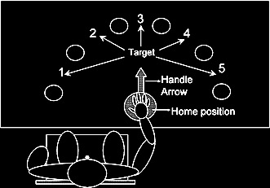
(Zhang and Rosenbaum 2007)
Notes:
Motor representations enable quite sophisticated planning over short periods of time and sequences of action; for example, how you grasp a pointer will depend on what you are about to do with it \citep{zhang:2007_planning}.
This sort of planning does not need intentions at all. So what are intentions for?

Slide 47
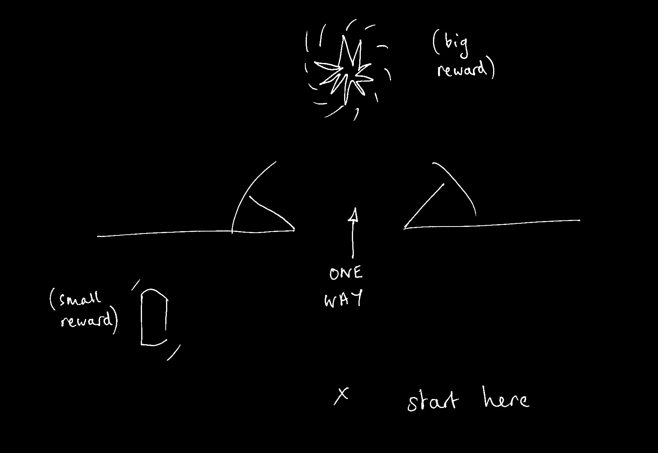
Notes:
\emph{Intentions are for planning multiple separate actions over longer periods of time; and for planning multiple separate actions whose execution is mutually constraining where the outcomes cannot be represented motorically.}
This is a case where intentions are really needed --- can’t act on strongest desire (for the big reward) if want to maximise rewards by collecting the small and the large reward.
And can’t rely on motor representation because the motor system doesn’t care about things that cannot be represented in motor terms.
Not all purposive actions involve any planning of this sort.
Now you could imagine a two-person version of this task where we are rewarded for what we collectively achieve. In this case it’s optimal if one of us goes for the small reward and the other goes for the large reward. I think it’s this kind of planning that shared intention is really for.

Slide 48
shared
What are intentions for?
Notes:
So what are intentions for?
I’m going to assume that intention is something over and above basic beliefs and desires; that an intention is not, for instance, merely a strongest desire.
There is a temptation to assume that intention is involved in every case of purposive action.
But it’s hard to see what the argument for this could be.
In many cases it seems that beliefs, desires and motor representations are all that is needed to explain purposive action.
You offer me a biscuit. I want one, and I believe I can get one by reaching out for it. So I do reach for it. As far as I can see, there’s no need to suppose that, in addition to the belief and desire, it must be the case that I also intend to take a biscuit.
(At least not unless we take ‘intention’ to mean ‘strongest desire’, which it does not.)
Maybe I do intend this.
But it’s possible for an agent to take and eat a biscuit, and to do so purposively, without having any intentions at all.
Beliefs desires and motor representations are sufficient.
So (again), what are intentions for?

Slide 49
Notes:
\emph{Intentions are for planning multiple separate actions over longer periods of time; and for planning multiple separate actions whose execution is mutually constraining where the outcomes cannot be represented motorically.}
This is a case where intentions are really needed --- can’t act on strongest desire (for the big reward) if want to maximise rewards by collecting the small and the large reward.
And can’t rely on motor representation because the motor system doesn’t care about things that cannot be represented in motor terms.
Not all purposive actions involve any planning of this sort.
Now you could imagine a two-person version of this task where we are rewarded for what we collectively achieve. In this case it’s optimal if one of us goes for the small reward and the other goes for the large reward. I think it’s this kind of planning that shared intention is really for.

Slide 50
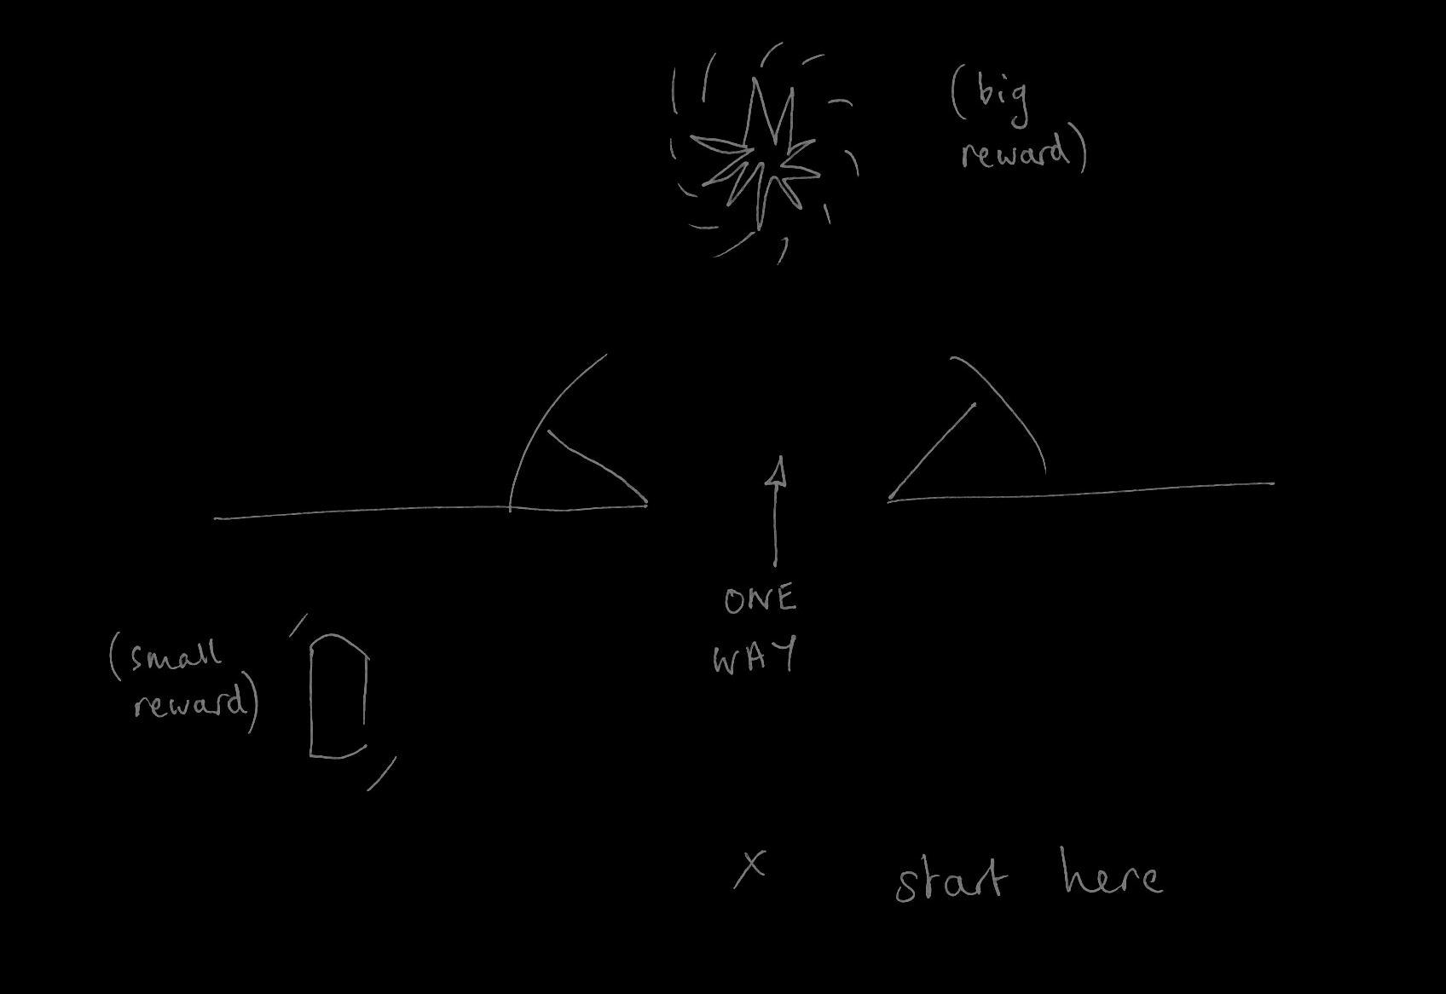
moving an object together
(Kourtis et al 2010)
tidying up the toys together
(Behne et al 2005)
cooperatively pulling handles in sequence to make a dog-puppet sing
(Brownell et al 2006)
bouncing a cube on a large trampoline together
(Tomasello & Carpenter 2007)
pretending to row a boat together
Notes:
By contrast, in many ordinary cases of joint action there is no need for planning of this sort and so no need for shared intention. Actions such as these \emph{might} involve shared intention but they do not \emph{necessarily} involve shared intention.
I’m suggesting that some joint actions---like the one two people move an object in a way that involves passing it between them---don’t require this kind of planning and so don’t necessarily involve shared intentions.
In some cases, social motor representation alone is sufficient for purposive joint action.

Slide 51
‘I take a collective action to involve a collective [shared] intention.’
(Gilbert 2006, p. 5)
‘The sine qua non of collaborative action is a joint goal [shared intention] and a joint commitment’
(Tomasello 2008, p. 181)
‘the key property of joint action lies in its internal component [...] in the participants’ having a “collective” or “shared” intention.’
(Alonso 2009, pp. 444-5)
‘Shared intentionality is the foundation upon which joint action is built.’
(Carpenter 2009, p. 381)
Notes:
This goes against a widely shared view in the literature

Slide 52
‘I take a collective action to involve a collective [shared] intention.’
(Gilbert 2006, p. 5)
‘The sine qua non of collaborative action is a joint goal [shared intention] and a joint commitment’
(Tomasello 2008, p. 181)
‘the key property of joint action lies in its internal component [...] in the participants’ having a “collective” or “shared” intention.’
(Alonso 2009, pp. 444-5)
‘Shared intentionality is the foundation upon which joint action is built.’
(Carpenter 2009, p. 381)
Notes:
To focus on just one case, Alonso says ‘the key property of joint action lies in its internal component [...] in the participants’ having a “collective” or “shared” intention.’
(Alonso 2009, pp. 444-5)
I want to spend a bit of time on this claim because it matters for my second theme, which is a problem concerning how motor representation and shared intention interface in joint action.
As far as I know, this claim is not explicitly argued for. From conversation with philosophers I think the central argument is supposed to contrast cases.
Contrast cases are pairs of actions which are similar in terms of behaviour and coordination but where one is joint but the other isn’t....

Slide 53
Joint
Not joint

Slide 54
Joint
Not joint
Jack and Sue walk together
Jack and Sue walk alongside each other
(Gilbert 1990)
Notes:
for example ...

Slide 55
Joint
Not joint
Jack and Sue walk together
Jack and Sue walk alongside each other
(Gilbert 1990)
We collectively perform a dance by running to a shelter at the same time
We each individually run to a shelter at the same time (in response to a sudden shower).
(Searle 1990, 92)
Notes:
These sorts of contrast case invite the question,
How do joint actions differ from individual actions which may occur in parallel?
What is the difference between Jack & Sue walking together and their walking side-by-side?
Gilbert’s example shows that the difference can’t just be a matter of coordination, because people merely walking alongside each other also need to coordinate their actions in order to avoid colliding with each other.
And Searle’s example shows that the difference between joint action and parallel individual action can’t just be that the actions have a common effect because merely parallel actions can have common effects too.
How might this lead someone to think that all joint action involves shared intention?
I think the idea is supposed to be this.
One difference between the genuinely joint actions and their merely parallel counterparts is that the genuinely joint actions involve shared intentions.
And there is no further difference that enables one systematically to distinguish the two cases.
I think this argument is mistaken.
First because there are contrast cases in which the joint action does not involve shared intention (***bouncing a cube on a trampoline---might be done by two people merely shaking the tramoline with no interest in, or awareness of, each other ; ***Ayesha & Beatrice lifting (i) as originally described [not joint] and (ii) involving reciprocal social motor representation.
It follows that appeal to shared intention does not provide a sufficiently general way of explaining the difference illustrated by the contrast cases.
Second because there is a more general notion appeal to which enables us to distinguish the contrast cases.
Genuine joint action differs from merely parallel action because the former involves each agent’s representing an outcome to which all of their actions are directed where these outcome representations coordinate their actions in a way that would normally facilitate their collective success in bring about this outcome.

Slide 56
Joint
Not joint
Jack and Sue walk together
Jack and Sue walk alongside each other
(Gilbert 1990)
We collectively perform a dance by running to a shelter at the same time
We each individually run to a shelter at the same time (in response to a sudden shower).
(Searle 1990, 92)
We lift a sofa together.
We each individually raise either end of a sofa, coincidentally at the same time.
Notes:
These sorts of contrast case invite the question,
How do joint actions differ from individual actions which may occur in parallel?
What is the difference between Jack & Sue walking together and their walking side-by-side?
Gilbert’s example shows that the difference can’t just be a matter of coordination, because people merely walking alongside each other also need to coordinate their actions in order to avoid colliding with each other.
And Searle’s example shows that the difference between joint action and parallel individual action can’t just be that the actions have a common effect because merely parallel actions can have common effects too.
How might this lead someone to think that all joint action involves shared intention?
I think the idea is supposed to be this.
One difference between the genuinely joint actions and their merely parallel counterparts is that the genuinely joint actions involve shared intentions.
And there is no further difference that enables one systematically to distinguish the two cases.
I think this argument is mistaken.
First because there are contrast cases in which the joint action does not involve shared intention (***bouncing a cube on a trampoline---might be done by two people merely shaking the tramoline with no interest in, or awareness of, each other ; ***Ayesha & Beatrice lifting (i) as originally described [not joint] and (ii) involving reciprocal social motor representation.
It follows that appeal to shared intention does not provide a sufficiently general way of explaining the difference illustrated by the contrast cases.
Second because there is a more general notion appeal to which enables us to distinguish the contrast cases.
Genuine joint action differs from merely parallel action because the former involves each agent’s representing an outcome to which all of their actions are directed where these outcome representations coordinate their actions in a way that would normally facilitate their collective success in bring about this outcome.

Slide 57
Joint
Not joint
Jack and Sue walk together
Jack and Sue walk alongside each other
(Gilbert 1990)
We collectively perform a dance by running to a shelter at the same time
We each individually run to a shelter at the same time (in response to a sudden shower).
(Searle 1990, 92)
We lift a sofa together.
We each individually raise either end of a sofa, coincidentally at the same time.
Notes:
(Actually I don’t think this is quite general enough because I think some joint actions involve non-representational coordinative structures only; I am also doubtful that there is a sharp distinction between merely parallel and genuinely joint action and I think it is possible to see the difference as a matter of degree. But I don’t want to get into that here. It’s sufficient that we have moved away from the bare shared intention account. [*WHAT WE REALLY NEED IS A COLLECTIVE OR SHARED GOAL, and the possibility of gradual construction shows that there’s no magic moment separating joint from parallel action.)
To sum up so far, I reject the claim that reflection on the contrast cases provides any support for the idea that all joint action involves shared intention.

Slide 58
premise:
Reciprocal agent-neutral motor representation enables joint action
question:
Does reciprocal agent-neutral motor representation also play a role in explaining what joint action is? [Yes]
challenge:
How could social motor representation and shared intention harmoniously contribute to joint action?
‘the key property of joint action lies in its internal component [...] in the participants’ having a “collective” or “shared” intention.’
(Alonso 2009, pp. 444-5)
Notes:
So far I have been assuming that there is an inconsistency between two claims:
(1) my claim that reciprocal reciprocal agent-neutral motor representation can ground purposive joint action
(2) many philosophers’ claim that all joint actions involve shared intention.
But maybe it is a mistake to think that these are inconsistent.
Why not suppose that some social motor representations are a variety of shared intentions?

Slide 59
premise:
Reciprocal agent-neutral motor representation enables joint action
question:
Does reciprocal agent-neutral motor representation also play a role in explaining what joint action is? [Yes]
challenge:
How could social motor representation and shared intention harmoniously contribute to joint action?
?
reciprocal agent-neutral motor representation
= shared intention?
‘the key property of joint action lies in its internal component [...] in the participants’ having a “collective” or “shared” intention.’
(Alonso 2009, pp. 444-5)
Notes:
If some reciprocal agent-neutral motor representations are shared intentions, then there is no inconsistency.
And what I’ve just been arguing is that agent-neutral motor representations resemble shared intentions in that both play a role in coordinating agents’ actions by virtue of representing outcomes. Isn’t that enough to justify identifying them as shared intentions?
This issue might easily seem narrowly conceptual or terminological.
At the end of the day it doesn’t much matter if we want to call some motor representations ‘shared intentions’.
After all, on most accounts shared intentions are neither shared nor intentions so we would hardly be doing more violence to the term than is already being done.
So insofar as labeling some social motor representations shared intentions might help to avoid unnecessarily philosophical discussion, I’m all in favour.
However, there is an important differences between the states normally regarded as shared intentions and any motor representations.
And this difference matters for understanding the interface between shared intention and motor representation.
[*PLAN for what follows:*]
Difference in format.
Leads to the interface problem.
Shared intentions can be inferentially integrated with other shared intentions; but not they cannot be inferentially integrated with social motor intentions (two disjoint planning processes).
Elisabeth Pacherie’s proposal: shared intentions set outcomes to be achieved by social motor representations.
I borrow this idea from her, but it raises a further problem.
The problem is how the one sets outcomes for the other given the difference in representational format.

Slide 60
How might reciprocal agent-neutral motor representations differ from shared intentions?
Notes:
In what respects do reciprocal agent-neutral motor representations differ from shared intentions?

Slide 61
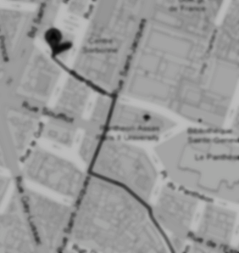

< different content >
Notes:
As background we first need a generic distinction between content and format. Imagine you are in an unfamiliar city and are trying to get to the central station. A stranger offers you two routes. Each route could be represented by a distinct line on a paper map. The difference between the two lines is a difference in content. Each of the routes could alternatively have been represented by a distinct series of instructions written on the same piece of paper; these cartographic and propositional representations differ in format. The format of a representation constrains its possible contents. For example, a representation with a cartographic format cannot represent what is represented by sentences such as `There could not be a mountain whose summit is inaccessible.'\footnote{ Note that the distinction between content and format is orthogonal to issues about representational medium. The maps in our illustration may be paper map or electronic maps, and the instructions may be spoken, signed or written. This difference is one of medium.} The distinction between content and format is necessary because, as our illustration shows, each can be varied independently of the other.

Slide 62
< different content >
Head southeast on Rue Cujas toward Rue Victor Cousin. Turn right onto Rue Saint-Jacques. ...
Take RER B and get out at the Luxembourg station, from there it's less than 5 minutes walk.
< different format >
Notes:
As background we first need a generic distinction between content and format. Imagine you are in an unfamiliar city and are trying to get to the central station. A stranger offers you two routes. Each route could be represented by a distinct line on a paper map. The difference between the two lines is a difference in content. Each of the routes could alternatively have been represented by a distinct series of instructions written on the same piece of paper; these cartographic and propositional representations differ in format. The format of a representation constrains its possible contents. For example, a representation with a cartographic format cannot represent what is represented by sentences such as `There could not be a mountain whose summit is inaccessible.'\footnote{ Note that the distinction between content and format is orthogonal to issues about representational medium. The maps in our illustration may be paper map or electronic maps, and the instructions may be spoken, signed or written. This difference is one of medium.} The distinction between content and format is necessary because, as our illustration shows, each can be varied independently of the other.

Slide 63
Head southeast on Rue Cujas toward Rue Victor Cousin. Turn right onto Rue Saint-Jacques. ...
=
?
Notes:
Format matters because only where two representations have the same format can they be straightforwardly inferentially integrated.
To illustrate, let’s stay with representations of routes.
Suppose you are given some verbal instructions describing a route. You are then shown a representation of a route on a map and asked whether this is the same route that was verbally described. You are not allowed to find out by following the routes or by imagining following them.
Special cases aside, answering the question will involve a process of translation because two distinct representational formats are involved, propositional and cartographic. It is not be enough that you could follow either representation of the route. You will also need to be able to translate from at least one representational format into at least one other format.

Slide 64
Only representations with a common format can be inferentially integrated.
Any two intentions can be inferentially integrated in practical reasoning.
My intention that I visit Paris on Friday is a propositional attitude.
Notes:
This brings me to the argument ...

Slide 65
Only representations with a common format can be inferentially integrated.
Any two intentions can be inferentially integrated in practical reasoning.
My intention that I visit Paris on Friday is a propositional attitude.
All intentions are propositional attitudes.

Slide 66
Only representations with a common format can be inferentially integrated.
Any two intentions can be inferentially integrated in practical reasoning.
My intention that I visit Paris on Friday is a propositional attitude.
All intentions are propositional attitudes.
No motor representations are propositional attitudes.
Notes:
This brings me to the argument ...

Slide 67
Only representations with a common format can be inferentially integrated.
Any two intentions can be inferentially integrated in practical reasoning.
My intention that I visit Paris on Friday is a propositional attitude.
All intentions are propositional attitudes.
No motor representations are propositional attitudes.
No motor representations are intentions
Notes:
This brings me to the argument ...

Slide 68
Only representations with a common format can be inferentially integrated.
Any two intentions can be inferentially integrated in practical reasoning.
My intention that I visit Paris on Friday is a propositional attitude.
All intentions are propositional attitudes.
No motor representations are propositional attitudes.
No motor representations are intentions
Notes:
This step is questionable. I don’t have an argument for this and I’m not sure it isn’t terminological.
What I care about is that we distinguish attitudes according to the processes in which they feature.
So if you like we could distinguish two kinds of intention, one propositional the other motor.
As long as we distinguish representations of different formats I don’t see that it matters too much whether we call them all intentions or whether we use that term for only some of them.

Slide 69
Only representations with a common format can be inferentially integrated.
Any two intentions can be inferentially integrated in practical reasoning.
My intention that I visit Paris on Friday is a propositional attitude.
All intentions are propositional attitudes.
No motor representations are propositional attitudes.
No motor representations are intentions
Notes:
So where does this leave us?
The question was whether reciprocal agent-neutral motor intentions could count as shared intentions.

Slide 70
premise:
Reciprocal agent-neutral motor representation enables joint action
question:
Does reciprocal agent-neutral motor representation also play a role in explaining what joint action is? [Yes]
challenge:
How could social motor representation and shared intention harmoniously contribute to joint action?
?
reciprocal agent-neutral motor representation
= shared intention?
‘the key property of joint action lies in its internal component [...] in the participants’ having a “collective” or “shared” intention.’
(Alonso 2009, pp. 444-5)
Notes:
In answer to that question, I think this:
(a)
IF you agree motor representations are not intentions,
THEN reciprocal agent-neutral motor representations are not shared intentions.
And
(b)
IF motor representations are a non-propositional variety of intention,
THEN reciprocal agent-neutral motor representations are a non-standard variety of shared intentions.
The key thing is that, either way, reciprocal agent-neutral motor representations cannot be inferentially integrated with shared intentions in practical reasonoing.
This leads to what I’ll call ‘The Interface Problem’

Slide 71
The Interface Problem:

Slide 72
The Interface Problem:
Some joint actions involve both shared intention and reciprocal agent-neutral motor representation

Slide 73
The Interface Problem:
Reciprocal agent-neutral motor representations:
i. represent outcomes;
ii. ground the purposiveness of some
joint actions
Some joint actions involve both shared intention and reciprocal agent-neutral motor representation

Slide 74
The Interface Problem:
Reciprocal agent-neutral motor representations:
i. represent outcomes;
ii. ground the purposiveness of some
joint actions
Two outcomes, A and B, match in a particular context just if, in that context, either the occurrence of A would normally constitute or cause, at least partially, the occurrence of B or vice versa.
Some joint actions involve both shared intention and reciprocal agent-neutral motor representation

Slide 75
The Interface Problem:
How are non-accidental matches possible?
Reciprocal agent-neutral motor representations:
i. represent outcomes;
ii. ground the purposiveness of some
joint actions
Two outcomes, A and B, match in a particular context just if, in that context, either the occurrence of A would normally constitute or cause, at least partially, the occurrence of B or vice versa.
Some joint actions involve both shared intention and reciprocal agent-neutral motor representation

Slide 76
The Interface Problem:
How are non-accidental matches possible?
Reciprocal agent-neutral motor representations:
i. represent outcomes;
ii. ground the purposiveness of some
joint actions; and
iii. differ in format from (the constituent attitudes of) shared intentions.
Two outcomes, A and B, match in a particular context just if, in that context, either the occurrence of A would normally constitute or cause, at least partially, the occurrence of B or vice versa.
Some joint actions involve both shared intention and reciprocal agent-neutral motor representation

Slide 77
The Interface Problem:
How are non-accidental matches possible?
Reciprocal agent-neutral motor representations:
i. represent outcomes;
ii. ground the purposiveness of some
joint actions; and
iii. differ in format from (the constituent attitudes of) shared intentions.
Two outcomes, A and B, match in a particular context just if, in that context, either the occurrence of A would normally constitute or cause, at least partially, the occurrence of B or vice versa.
Some joint actions involve both shared intention and reciprocal agent-neutral motor representation
Notes:
in conclusion ...

